Slide 1

Installation of
PostgreSQL & pgadmin

Slide 2




Four easy steps to complete this exercise
Install PostgreSQL & pgAdmin ( Windows 10 and Mac OS )
Setup pgAdmin
Install psycopg2 library using Anaconda
Run the necessaries at Jupyter. ( Localhost_PostgreSQL_Source_Code.ipynb )

Slide 3


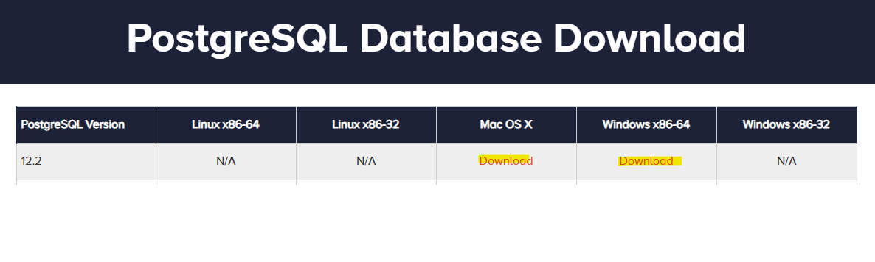
Install PostgreSQL & pgAdmin
https://www.enterprisedb.com/downloads/postgres-postgresql-downloads

Slide 4
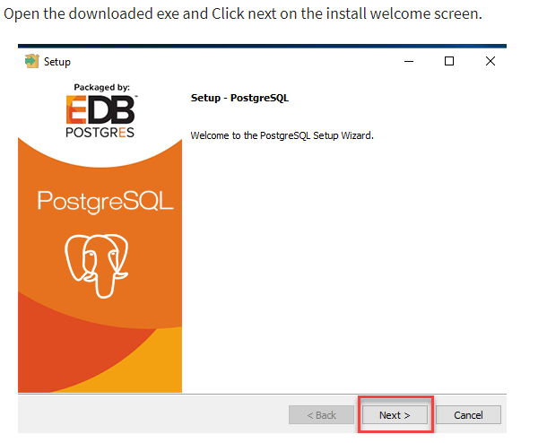

Slide 5
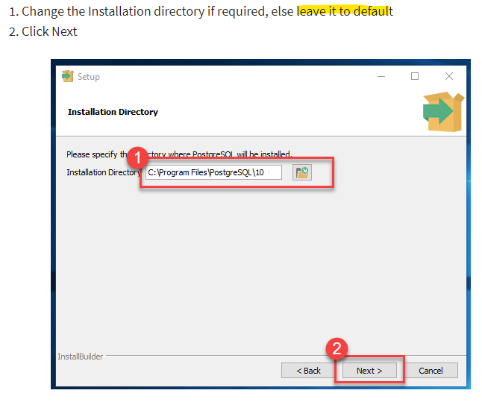

Slide 6
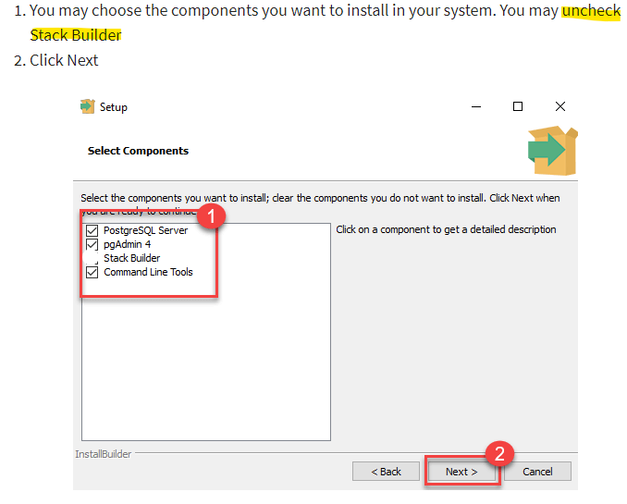

Slide 7
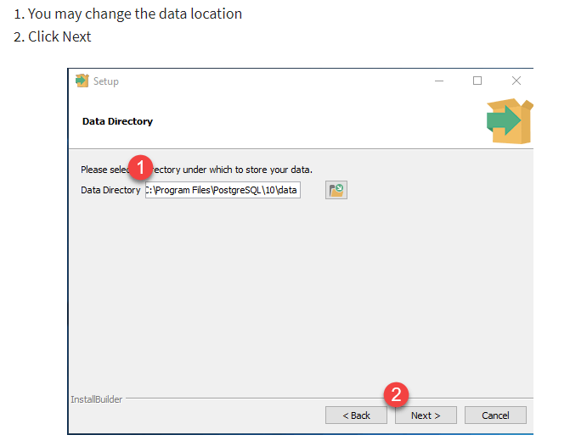

Slide 8
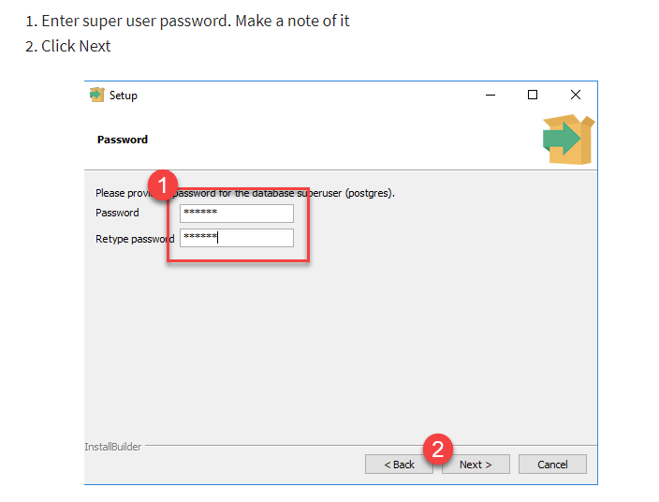
Input password as pwd

Slide 9
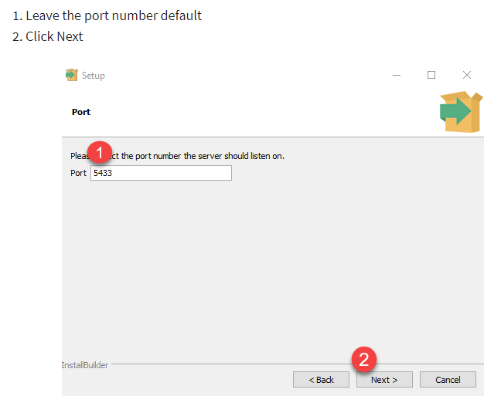
Take note of the port

Slide 10
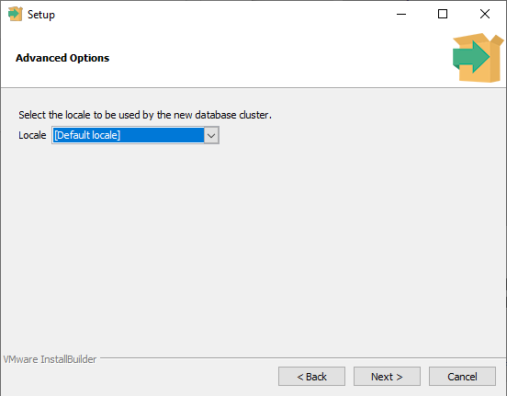

Slide 11
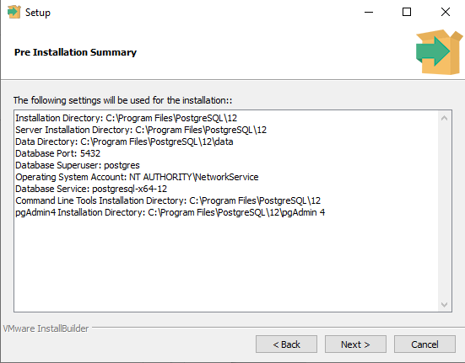

Slide 12
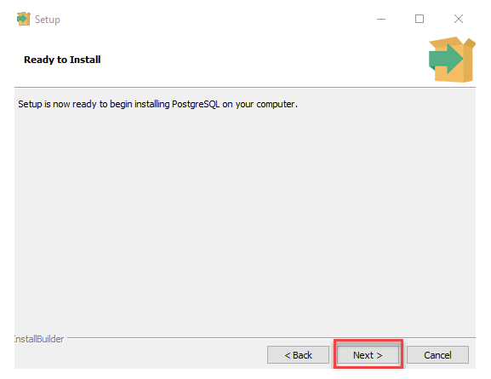

Slide 13
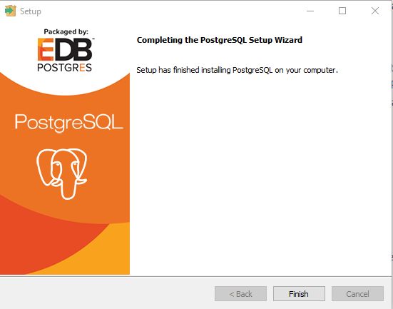

Slide 14
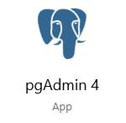
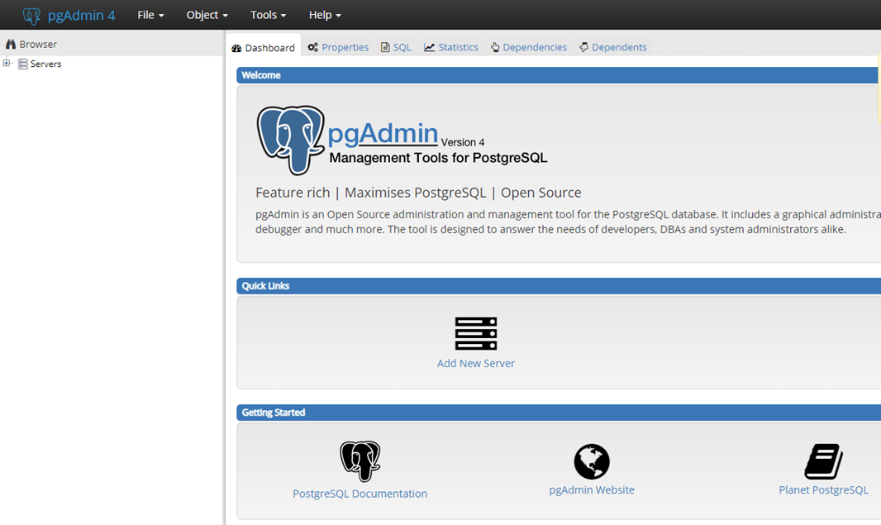

Step 2 : Setup pdAdmin4
Launch
It will be launched via browser

Slide 15
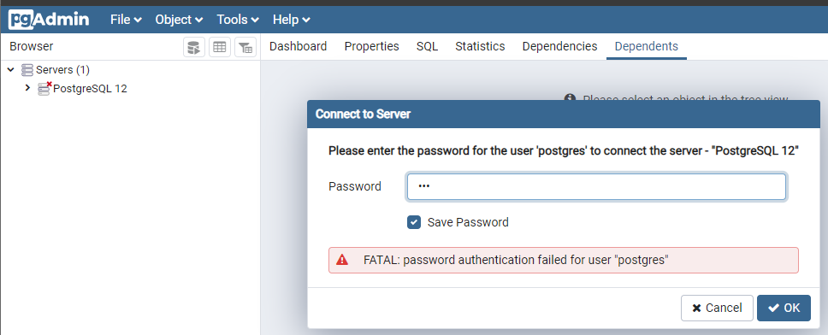
Input pwd as password

Slide 16
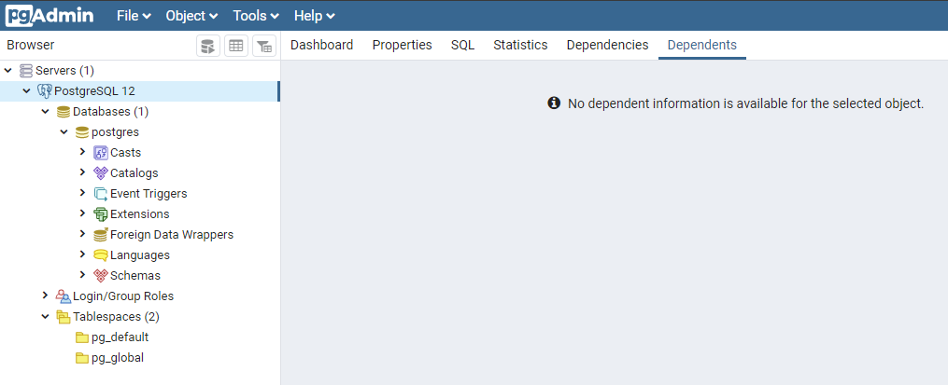

Slide 17
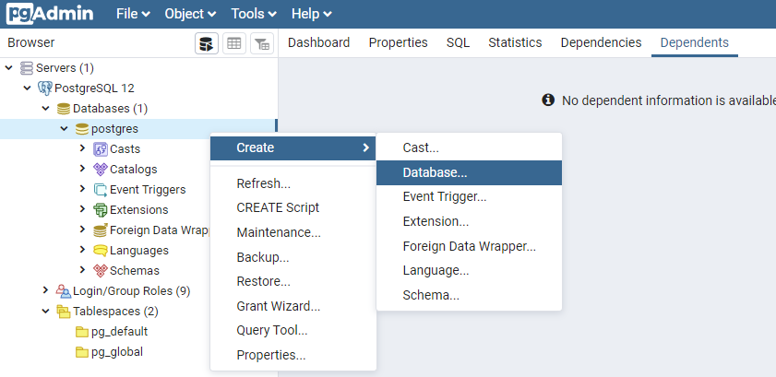
Create Database

Slide 18
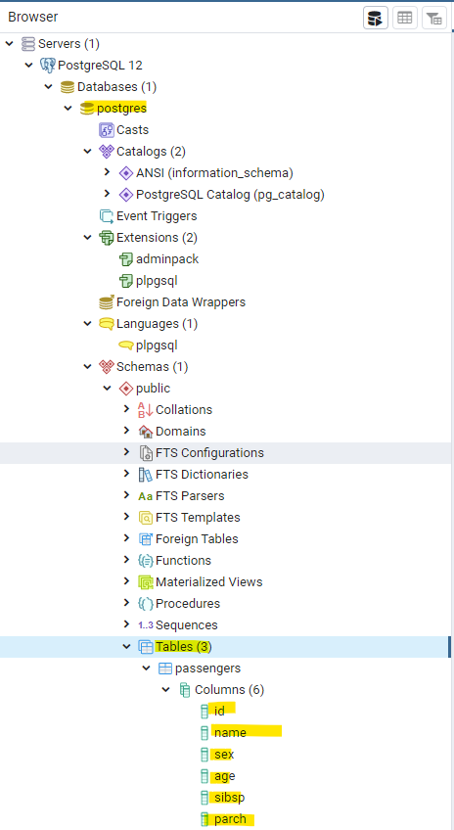

Slide 19
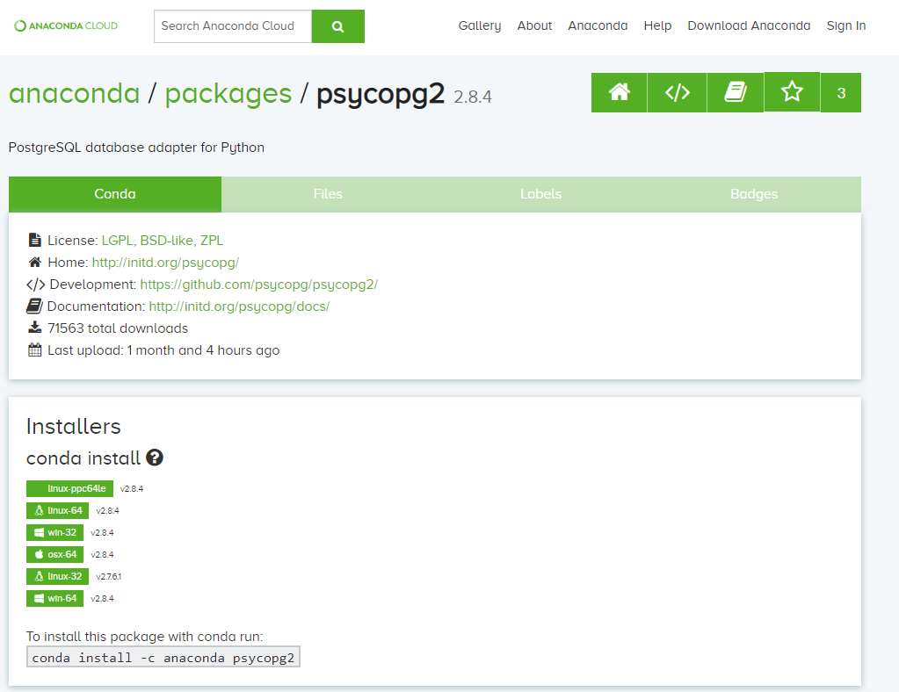
3. At Anaconda Prompt conda install -c anaconda psycopg2
optional info about the library :
https://pypi.org/project/psycopg2/

Slide 20
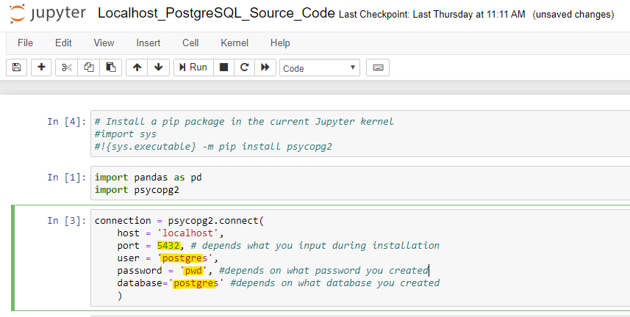
4. Jupyter

Slide 21


